Slide 1



Noida Institute of Engineering and Technology, Greater Noida
Concept of CCS & Bootstrap
Unit: 3
Web Technology Subject Code is not Assigned)
Ajeet Kumar
Assistant Professor
CSE
Course Details (Ex: B Tech 5th Sem)

Slide 2
Subject Syllabus
Unit -1 | Basics of Web Technology & Web Hosting | 8 Hours
Introduction: Introduction to Web Technology, History of Web and Internet, Connecting to Internet, Introduction to Internet services and tools, Client-Server Computing, Protocols Governing Web, Basic principles involved in developing a web site, Planning process, Types of Websites,WebStandardsandW3C recommendations, Web Hosting: Web Hosting Basics, Types of Hosting Packages, Registering domains, Defining Name Servers, Using Control Panel, Creating Emails in C panel, Using FTP Client, Maintaining a Website.
Unit-2 | Introduction to HTML & XML | 8 Hours
HTML: What is HTML, DOM- Introduction to Document Object Model, Basic structure of an HTML documents, Markup Tags, Heading-Paragraphs, Line Breaks, Understand the structure of HTML tables. Lists, Working with Hyperlinks, Image Handling, Understanding Frames and their needs, HTML forms for User inputs. New form Elements- date, number, range, email, search and datalist, Understanding audio, video and article tags. XML: Introduction, Tree, Syntax, Elements, Attributes, Namespaces, Display, HTTP request, Parser, DOM, XPath, XSLT, XQuerry, XLink, Validator, DTD, Schema, Server

Slide 3
Subject Syllabus
Unit-3 | Concepts of CSS3& Bootstrap | 8 Hours
Concept of CSS 3: Creating Style Sheet, CSS Properties , CSS Styling(Background, Text Format, Controlling Fonts) , Working with block elements and objects , Working with Lists and Tables ,CSS Id and Class, Box Model (Introduction,Borderproperties,PaddingProperties,Marginproperties) CSS Advanced(Grouping, Dimension, Display, Positioning, Floating, Align, Pseudo class, Navigation Bar, Image Sprites, Attribute sector), CSS Color, Creating page Layout and Site. Bootstrap: Introduction, Bootstrap grid system, Bootstrap Components.
Unit-4 | JavaScript and ES6 | 8 Hours
JavaScript Essentials: Introduction to Java Script ,Java script Types , Var, Let and Const Keywords, Operators in JS , Conditions Statements , Java Script Loops, JS Popup Boxes , JS Events , JSArrays,WorkingwithArrays,JSObjects,JSFunctions,UsingJavaScriptinRealtime,ValidationofForms,Arrow functions and default arguments, Template Strings, Strings methods, Callback functions, Object de-structuring, Spread and Rest Operator, Typescript fundamentals, Typescript OOPs- Classes, Interfaces, Constructor etc. Decorator and Spread Operator, Difference == & ===, Asynchronous Programming in ES6, Promise Constructor, Promise with Chain, Promise Race.

Slide 4
Subject Syllabus
Unit-5 | Introduction to PHP | 8 Hours
Introduction to PHP, Basic Syntax, Variables & Constants, Data Type, Operator & Expressions, Control flow and Decision making statements, Functions, Strings, Arrays, Working with files and directories: Understanding file& directory, Opening and closing, a file, Coping, renaming and deleting a file, working with directories, Creating and deleting folder, File Uploading & Downloading. Session & Cookies: Introduction to Session Control, Session Functionality What is a Cookie, Setting Cookies with PHP. Using Cookies with Sessions, Deleting Cookies, Registering Session variables, Destroying the variables and Session.

Slide 5
Text Books
Text books:
1. Steven M. Schafer, “HTML, XHTML, and CSS Bible, 5ed”, Wiley India
2. Ian Pouncey, Richard York, “Beginning CSS: Cascading Style Sheets for Web Design”, Wiley India

Slide 6

End Semester Question Paper Template
B TECH
(SEM-V) THEORY EXAMINATION 20__-20__
Time: 3 Hours Total Marks: 100
Note: 1. Attempt all Sections. If require any missing data; then choose suitably.
SECTION A
Attempt all questions in brief. 1 x 10 = 10
Q.No. | Question | Marks | CO
1 |  | 1
2 |  | 1
. |  | .
10 |  | 1

Slide 7
End Semester Question Paper Templates
2. Attempt of the following: 5 x 2 = 20
SECTION B
3. Attempt any five part of the following: 5 x 6 = 30
Q.No. | Question | Marks | CO
1 |  | 2
2 |  | 2
. |  | .
5 |  | 2
Q.No. | Question | Marks | CO
1 |  | 6
. |  | 6
7 |  | 6

Slide 8
End Semester Question Paper Templates
4. Attempt any one part of the following: 1 x 10 = 10
5. Attempt any one part of the following: 1 x 10 = 10
6. Attempt any one part of the following: 1 x 10 = 10
Q.No. | Question | Marks | CO
1 |  | 10
2 |  | 10
Q.No. | Question | Marks | CO
1 |  | 10
2 |  | 10
Q.No. | Question | Marks | CO
1 |  | 10
2 |  | 10

Slide 9
End Semester Question Paper Templates
7. Attempt any one part of the following: 1 x 10 = 10
8. Attempt any one part of the following: 1 x 10 = 10
Q.No. | Question | Marks | CO
1 |  | 10
2 |  | 10
Q.No. | Question | Marks | CO
1 |  | 10
2 |  | 10

Slide 10
Prerequisite
Basic Knowledge of any programming language like C/C++/Python/Java.
Familiarity with basic concepts of Internet.

Slide 11
Brief Introduction About The Subject
Web technologies are the various tools and techniques that are utilized in the process of communication between different types of devices over the internet.
To understand this term in a better manner, let’s break it down into two pieces: ‘web’ and ‘technology’.
The web, in this case, refers to the World Wide Web, more commonly known as WWW.
It first came into being in 1989 when famous scientist and engineer, Tim Berners-Lee, came up with an efficient mechanism to share resources between scientists all over the world.
https://www.youtube.com/results?search_query=Web+Technonogies

Slide 12

Unit 3 Content
Introduction:
Creating Style Sheet
CSS Properties
CSS Styling(Background, Text Format, Controlling Fonts) , Working with block elements and objects , Working with Lists and Tables CSSId and Class BoxModel(Introduction,Borderproperties,PaddingProperties,Marginproperties)
CSS Advanced(Grouping, Dimension, Display, Positioning, Floating, Align, Pseudo class, Navigation Bar, Image Sprites, Attribute sector)
CSS Color, Creating page Layout and Site.
Bootstrap: Introduction, Bootstrap grid system, Bootstrap Components.

Slide 13

Unit Objective
Objective of Unit 3:
To learn about web development strategies with Creating style sheet, Creating Properties
To understand the basic concepts to develop the Working with block elements and objects.
To understand Bootstrapping and Bootstrapping Components.
To understand to register a domain and maintain CSS Style Sheet.

Slide 14
Topic Objective
Objective of the above topics:
To get the knowledge about the CSS Style and Tools.
To know how to CSS with Bootstrapping Process.
To understand the components and their functionalities of CSS Advanced Grouping, dimensions, display.
To know the web standards to develop a website according to the CSS Pseudo class and image.

Slide 15
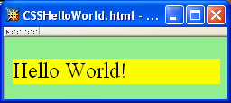
Concept of CSS 3: Creating Style Sheet
Cascading Style Sheets (CSS)
Applies to (X)HTML as well as XML documents in general
A styled HTML document.
produced by the style sheet style1.css:

Slide 16
Concept of CSS 3: Creating Style Sheet

Slide 17
Concept of CSS 3: Creating Style Sheet

Slide 18
Concept of CSS 3: Creating Style Sheet
href attribute provides style sheet URL

Slide 19
Concept of CSS 3: Creating Style Sheet

Slide 20
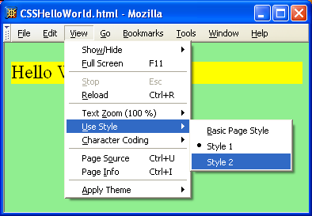
Concept of CSS 3: Creating Style Sheet
Note that alternate, user selectable style is not widely supported: firefox 3 and IE 8 do, but IE 6, IE 7 and Chrome don’t.

Slide 21
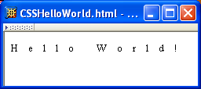
Concept of CSS 3: Creating Style Sheet
A styled HTML document
produced by the style sheet style2.css
Note that alternate, user selectable style is not widely supported: firefox 3 and IE 8 do, but IE 6, IE 7 and Chrome don’t.

Slide 22
Concept of CSS 3: Creating Style Sheet
Single document can be displayed on multiple media platforms by tailoring style sheets:
This document will be printed differently than it is displayed

Slide 23
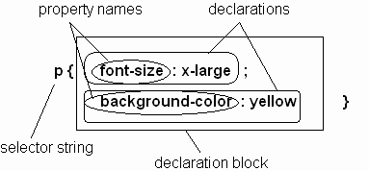
Concept of CSS 3:CSS Properties
Parts of a style rule (or statement)

Slide 24
Concept of CSS 3:CSS Properties
Single element type:
Multiple element types:
All element types:
Specific elements by id:

Slide 25
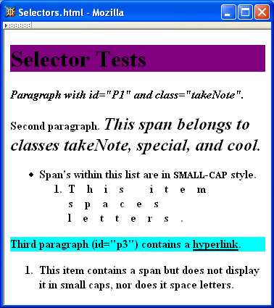
Concept of CSS 3:CSS Properties

Slide 26
Concept of CSS 3:CSS Properties
Elements belonging to a style class:
Referencing a style class in HTML:
Elements of a certain type and class:
class selector: begins with a period .

Slide 27
Concept of CSS 3:CSS Properties
Elements belonging to a style class:
Referencing a style class in HTML:
Elements of a certain type and class:
this span belongs to three style classes

Slide 28
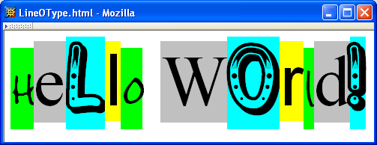
Concept of CSS 3:CSS Styling
A font is a mapping from code points to glyphs
Glyph (visual representation)
character cell
(content area)

Slide 29
Concept of CSS 3:CSS Styling
A font is a mapping from code points to glyphs
glyphs do not necessary stay inside cells!

Slide 30
Concept of CSS 3:CSS Styling
A font is a mapping from code points to glyphs
Glyph (visual representation)
character cell
(content area)

Slide 31
Concept of CSS 3:CSS Styling
A font family is a collection of related fonts (typically differ in size, weight, etc.)
font-family property can accept a list of families, including generic font families
first choice font

Slide 32
Concept of CSS 3:CSS Styling
A font is a mapping from code points to glyphs
Glyph (visual representation)
character cell
(content area)

Slide 33
Concept of CSS 3:CSS Styling
A font family is a collection of related fonts (typically differ in size, weight, etc.)
font-family property can accept a list of
families, including generic font families
second choice font

Slide 34
Concept of CSS 3:CSS Styling
A font family is a collection of related fonts (typically differ in size, weight, etc.)
font-family property can accept a list of families, including generic font families
generic

Slide 35
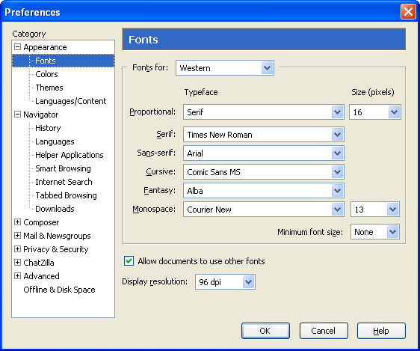
Concept of CSS 3:CSS Styling
generic
fonts are
system-
specific

Slide 36
Note that most generic font can be easily set on Firefox and Chrome, but such option doesn’t seem to be available on IE 7 and 8. IE will still default to something although maybe not what you had hoped for!

Slide 37
Concept of CSS 3:CSS Styling
generic
fonts are
system-
specific

Slide 38
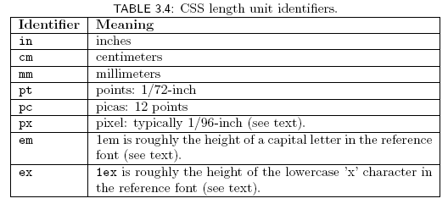
Concept of CSS 3:CSS Styling
Many properties, such as font-size, have a value that is a CSS length
All CSS length values except 0 need units

Slide 39
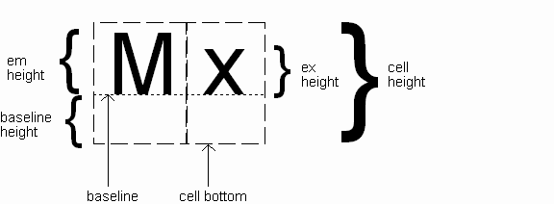
Concept of CSS 3:CSS Styling
Computed value
of font-size property

Slide 40
Concept of CSS 3:CSS Styling
Reference font defines em and ex units
Normally, reference font is the font of the element being styled
Exception: Using em/ex to specify value for font-size
parent element’s font is
reference font

Slide 41
Concept of CSS 3:CSS Styling
Other ways to specify value for font-size:
Percentage (of parent font-size) Absolute size keyword: xx-small, x-small, small, medium (initial value), large, x-large, xx-large
User agent specific; should differ by ~ 20%
Relative size keyword: smaller, larger
Relative to parent element’s font

Slide 42
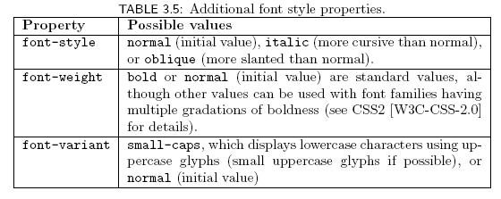
Concept of CSS 3:CSS Styling

Slide 43

Concept of CSS 3:CSS Styling
Text is rendered using line boxes
Height of line box given by line-height
Initial value: normal (i.e., cell height; relationship with em height is font-specific)
Other values (following are equivalent):

Slide 44
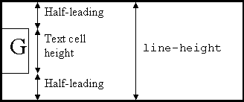
Concept of CSS 3:CSS Styling
When line-height is greater than cell height:
Inheritance of line-height:
Specified value if normal or unit-less number
Computed value otherwise

Slide 45
Concept of CSS 3:CSS Styling
font shortcut property:

Slide 46
Concept of CSS 3:CSS Styling
font shortcut property:
Initial values used if no value specified in font
property list (that is, potentially reset)

Slide 47
Concept of CSS 3:CSS Styling
font shortcut property:
specifying line-height (here, twice cell height)
size and family required,
order-dependent
any order

Slide 48
Concept of CSS 3:CSS Styling

Slide 49
Concept of CSS 3:CSS Styling
Font color specified by color property
Two primary ways of specifying colors:
Color name: black, gray, silver, white, red, lime, blue, yellow, aqua, fuchsia, maroon, green, navy, olive, teal, purple, full list at http://www.w3.org/TR/SVG11/types.html#ColorKeywords
red/green/blue (RGB) values

Slide 50
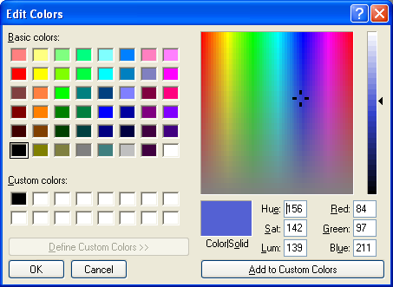
Concept of CSS 3:CSS Styling

Slide 51
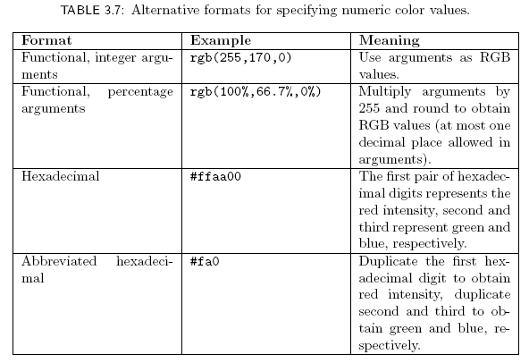
Concept of CSS 3:CSS Styling

Slide 52
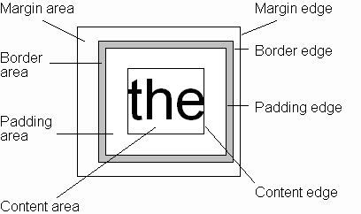
Concept of CSS 3:CSS Box Model
Every rendered element occupies a box:
(or outer edge)
(or inner edge)

Slide 53
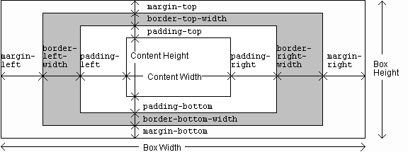
Concept of CSS 3:CSS Box Model

Slide 54
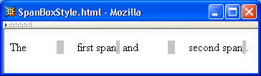
Concept of CSS 3:CSS Box Model

Slide 55
Concept of CSS 3:CSS Box Model

Slide 56
Concept of CSS 3:CSS Box Model

Slide 57
Concept of CSS 3:CSS Box Model

Slide 58
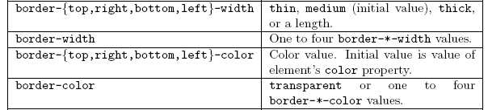
Concept of CSS 3:CSS Box Model

Slide 59
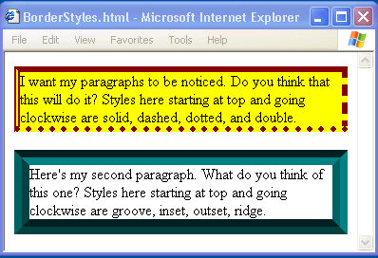
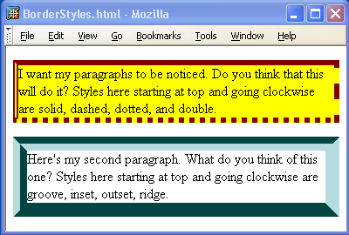
Concept of CSS 3:CSS Box Model

Slide 60
Concept of CSS 3:CSS Box Model

Slide 61
Concept of CSS 3:CSS Box Model
If multiple declarations apply to a property, the last declaration overrides earlier specifications
Left border is 30px wide,
inset style, and red

Slide 62
Concept of CSS 3:CSS Advanced(Grouping styles)
You can give the same properties to a number of selectors without having to repeat them by separating the selectors by commas. It is a useful thing for reducing file size.
Example
h2
{
color: red;
}
.thisOtherClass
{
color: red;
}
.yetAnotherClass
{ color: red; }
h2, .thisOtherClass, .yetAnotherClass
{
color: red;
}
Grouped CSS
h1, h2, h3, h4, h5, h6
{
color: blue;
}
Normal CSS

Slide 63
Concept of CSS 3:CSS Advanced(Nested Styles)
If the CSS is structured well, there shouldn't be a need to use many class or ID selectors. This is because you can specify properties to selectors within other selectors.
#top { background-color: #ccc; padding: 1em }
#top h1 { color: #ff0; }
#top p { color: red; font-weight: bold; }

Slide 64
Concept of CSS 3:CSS Advanced(Conditional CSS)
a[href $='.pdf'] { padding-right: 18px; background: transparent url(icon_pdf.gif) no-repeat center right; }
This would attach a pdf icon to the right of any hyperlink who's URL ended in '.pdf' like this. This was pretty exciting and heady stuff. It meant I could show the file type visually with that application's icon just by including a few lines in my master css file. I didn't have to worry about it at all in my html, css would add the icon for me automatically.

Slide 65
Concept of CSS 3:CSS Advanced
span[id ^='google'] { background-color: green; }
Any span which has an id which starts with 'google' will be assigned a green background.
More Examples

Slide 66
Concept of CSS 3:CSS Advanced
.ie .example { background-color: yellow } .gecko .example { background-color: gray } .opera .example { background-color: green } .konqueror .example { background-color: blue } .webkit .example { background-color: black } .example { width: 100px; height: 100px; background-color: brown; }

Slide 67
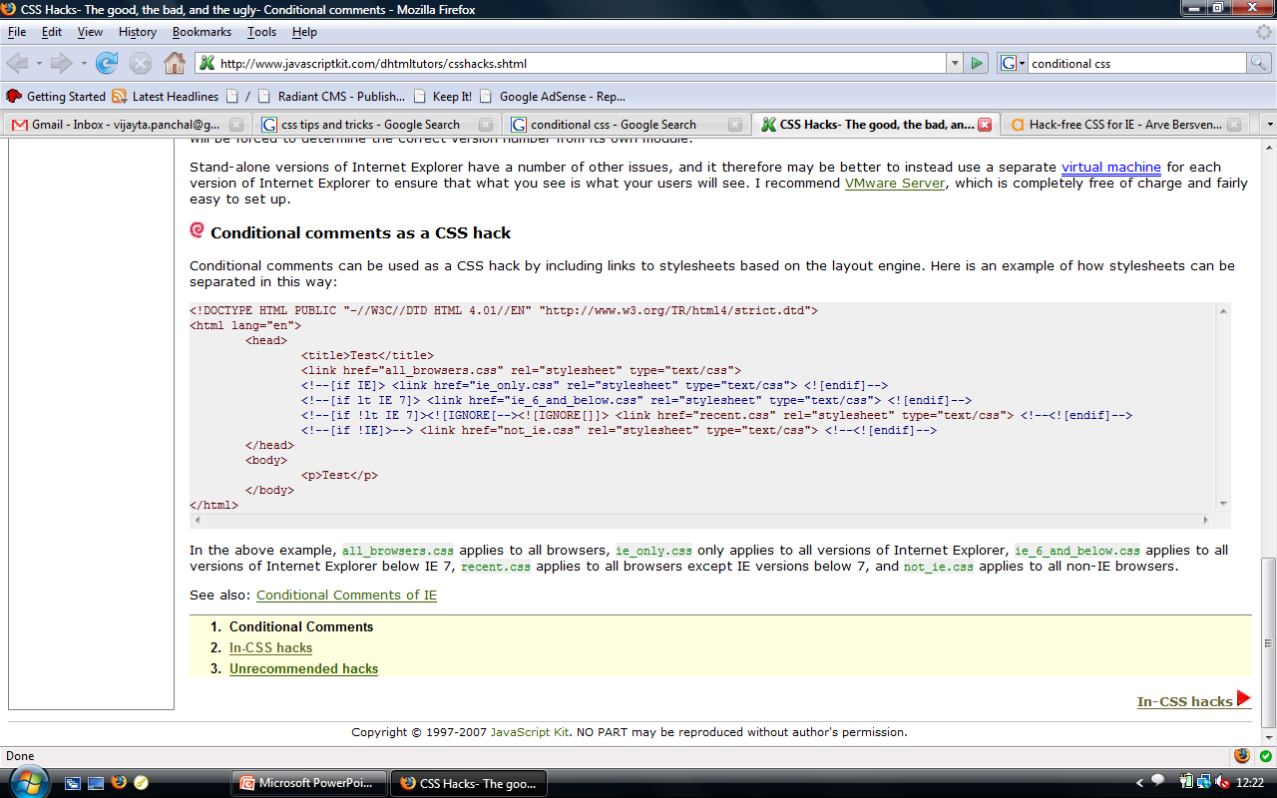
Concept of CSS 3:CSS Advanced(Cont..)

Slide 68
Concept of CSS 3:CSS Advanced(Validation)(Cont..)
Validate your HTML validator.w3.org
Validate your CSS jigsaw.w3.org/css-validator/
Check for web accessibility bobby.watchfire.com

Slide 69
Concept of CSS 3:Bootstrap
Bootstrap is a free front-end framework for faster and easier web development.
Bootstrap includes HTML and CSS based design templates for typography, forms, buttons, tables, navigation, modals, image carousels and many other, as well as optional JavaScript plug-in
Bootstrap also gives you the ability to easily create responsive designs.
Responsive web design is about creating web sites which automatically adjust themselves to look good on all devices, from small phones to large desktops.

Slide 70
Concept of CSS 3:Bootstrap
Bootstrap is the most popular HTML, CSS, and JavaScript framework for developing responsive, mobile-first web sites.
Advantages of Boot Strapping-
Easy to use: Anybody with just basic Knowledge of HTML and CSS can start using Bootstrap.
Responsive features: Bootstrap’s responsive CSS adjusts to phones, tablets, and desktops.
Mobile –First approach: In Bootstrap 3, mobile first styles are part of the core framework.

Slide 71
Concept of CSS 3:Bootstrap
This is the strongest part of bootstrap framework. Bootstrap offers a 12 column grid system. The grid system is responsive, that it adjust itself depending upon the device resolution of the client. These grids have further classes that have been defined in sync with the device resolution that they are represent.
These grids have classes xs, sm, md and lg each representing a device resolution. All the developer needs to do is include these classes while defining the visibility of element in the mark-up and hence come up with a responsive website. The responsive grid makes developing responsive websites really easy using bootstrap.

Slide 72
Topic
Concept of CSS 3:Bootstrap
Bootstrap Components
Bootstrap.css
This is the basic Bootstrap package that you will need to download. CSS is a style sheet language for static information.
Bootstrap.js
A JavaScript/JQuery library that powers up certain components of Bootstrap such as animation, scrolling, and interactivity.
Glyphicons
Glyphs are elemental symbols with typography, such as the English Pound symbol (£). Bootstrap has a huge list of embedded glyph icons that are available for free.

Slide 73
Concept of CSS 3:Bootstrap
Bootstrap source code elements
Bootstrap Screen Sizes The Bootstrap source code download includes the precompiled CSS, JavaScript, and font assets, along with source Less, JavaScript, and documentation.
less/ - a preprocessor style sheet for CSS that eliminate repetitive coding tasks
sass/ - a newer version of the preprocessor that is more popular
js/ - simply refers to the source code JavaScript, which allows Bootstrap components to work
fonts/ - these are icon fonts that come with the download
dist/ - a folder that contains precompiled files for drop-in use in website development

Slide 74
Faculty Video Links, Youtube & NPTEL Video Links and Online Courses Details
Youtube/other Video Links
https://getbootstrap.com/docs/3.3/components/
https://websitesetup.org/wp-content/uploads/2020/03/Bootstrap-Cheat-Sheet-websitesetup.org_.pdf
https://wiki.lib.sun.ac.za/images/0/07/Bootstrap-tutorial.pdf
https://youtu.be/1Rs2ND1ryYc

Slide 75
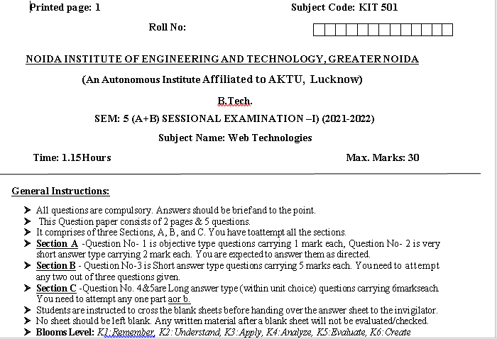
Sessional Papers

Slide 76
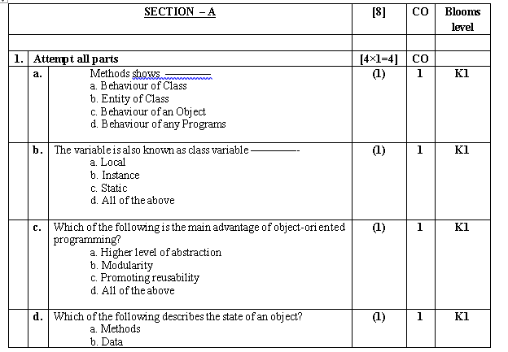
Sessional Papers

Slide 77
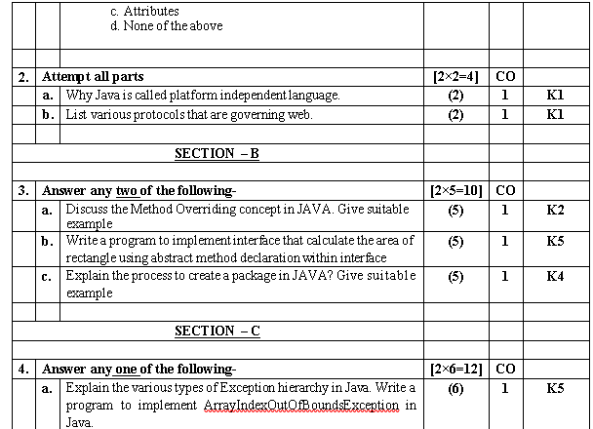
Sessional Papers

Slide 78
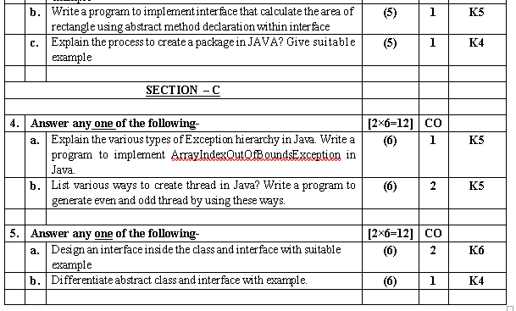
Sessional Papers

Slide 79
References
.
Burdman, Jessica, “Collaborative Web Development” Addison Wesley
Xavier, C, “ Web Technology and Design” , New Age International
Ivan Bayross,” HTML, DHTML, Java Script, Perl & CGI”, BPB Publication

Slide 80
Recap of Unit 3
Discussed about the concepts of CSS and its advantages
Discussed about various types CSS with its uses and properties
Discussed the various types of Bootstrapping techniques in web technology.
Discussed about various fonts and color using CSS properties to make our page interactive

